Slide 1
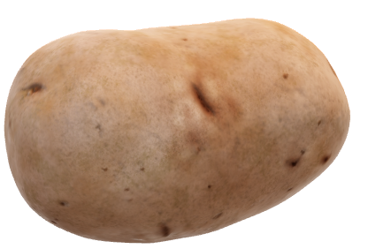
Potato Disease Classification
By Ravina Ingole

Slide 2
Problem Statement
Farmers are facing lots of agricultural problem because of different diseases on plants in which two common disease are early blight and late blight.
If farmers detect these diseases early and treat them it can save lot of waste and prevent economy loss.

Slide 3

Aim and objective
Our goal is to classify disease based on different image by using machine learning model.
Have used Kaggle Dataset (1890 number of images).

Slide 4
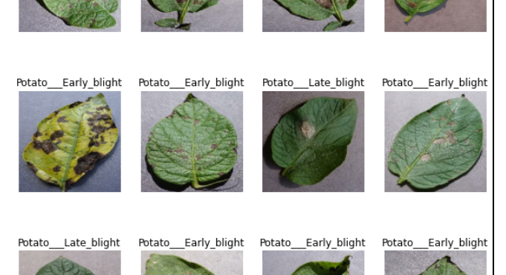
Some of the images from dataset
Types of Classification
1.Early Blight
2.Late Blight
3.Healthy Potato

Slide 5

Image preprocessing:
Data set
Batch Load, shuffle, Filter and Map
Model

Slide 6
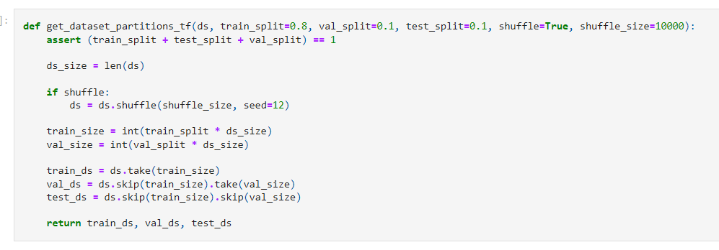
Data split
Load image from images folder.
Convert image content to NumPy array.
Extract label from folder.
Filter Blurred images

Slide 7
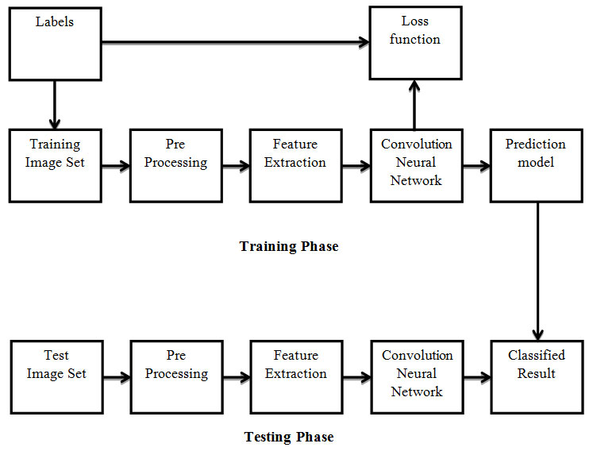
Model Architecture
Libraries used:
TensorFlow
Matplotlib
IPython display

Slide 8
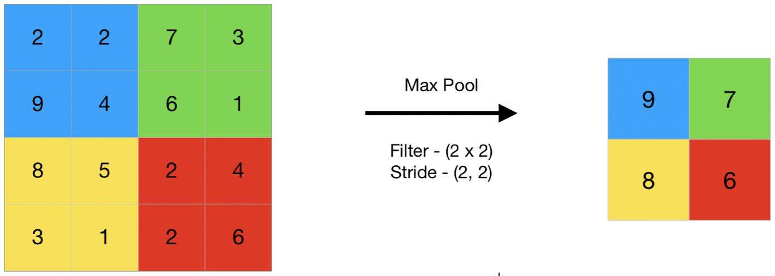
Max Pooling
Help reduce over-fitting
Reduces the computational cost

Slide 9
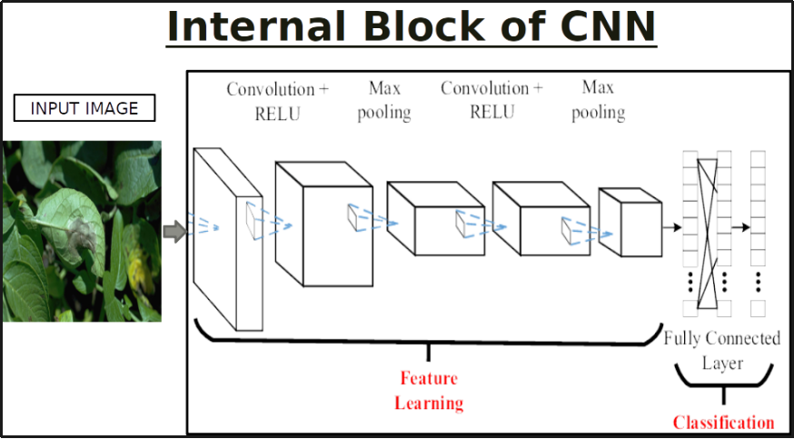
Model Architecture
Convolutional neural network with softmax.
Resizing
Normalization
Data Augmentation
Max Pooling

Slide 10
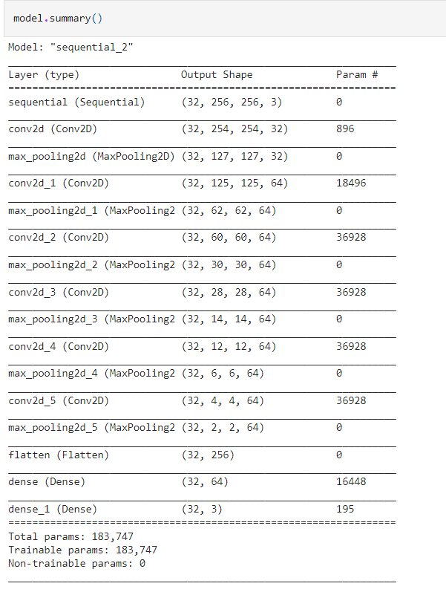
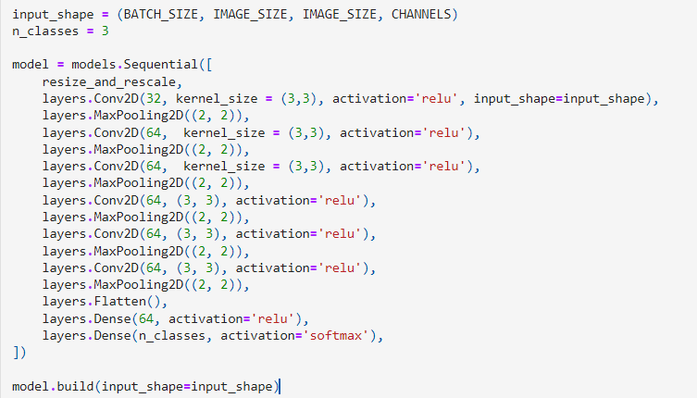
Model Summary

Slide 11
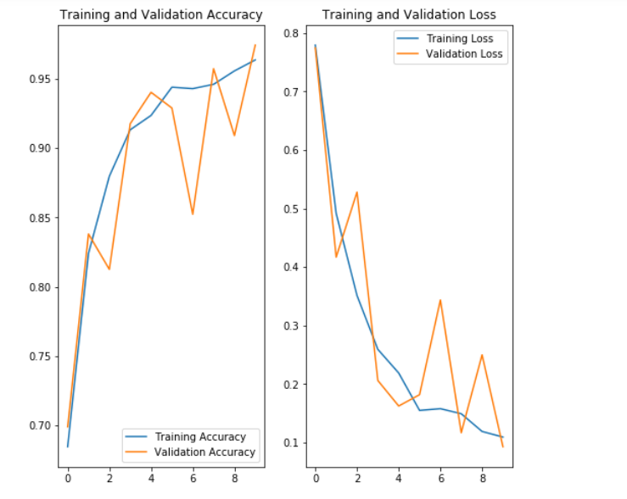
Results:
Values of losses, accuracy at the end of each epoch.
Total epoch: 10
Accuracy is increasing.
Losses are decreasing.

Slide 12
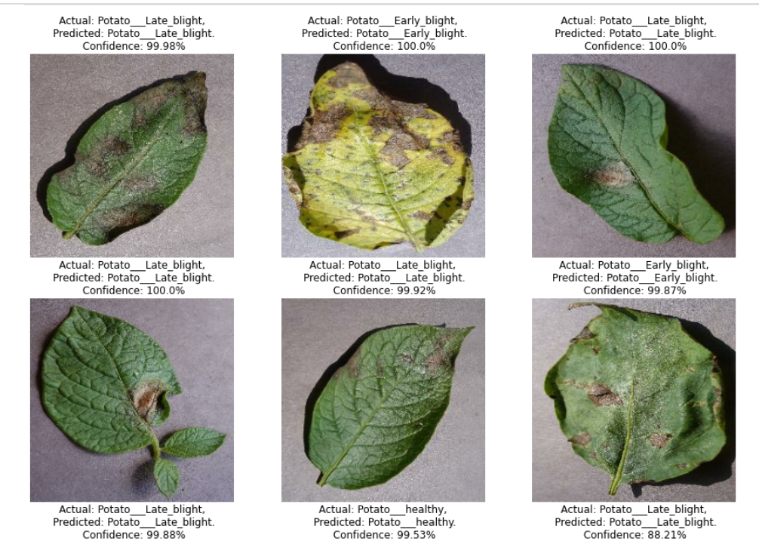
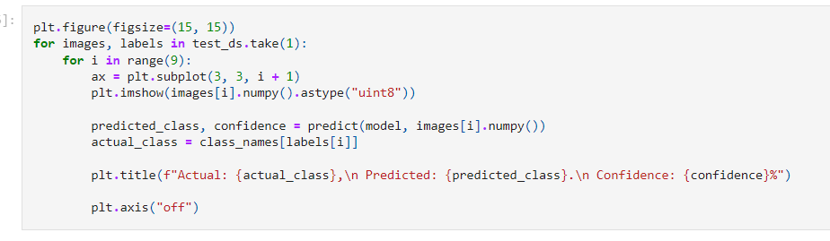
Conclusion:
Accuracy | 97%

Slide 13
Thank You.

